Slide 1

OBAYDULLAH KHAN ID: 201002093
Home Automation Using Microcontroller
and Android App.
Presented by,
Rukaiya Afroze Id:201002180
Dept. of Computer science & engineering ,
Green University of Bangladesh

Slide 2
Index
Introduction
ESP 8266
Features of ESP 8266
Relay module
Others Components
Procedure & Others

Slide 3
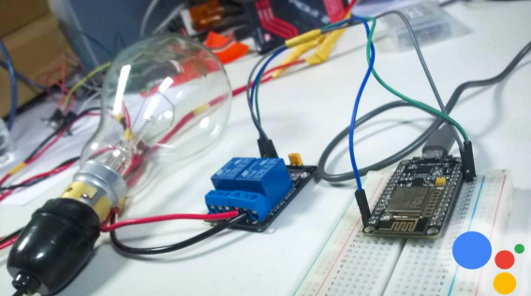
Introduction
Home Automation
Using
Microcontroller and Android App
Automation
simplicity
Internet of Things (IOT)

Slide 4
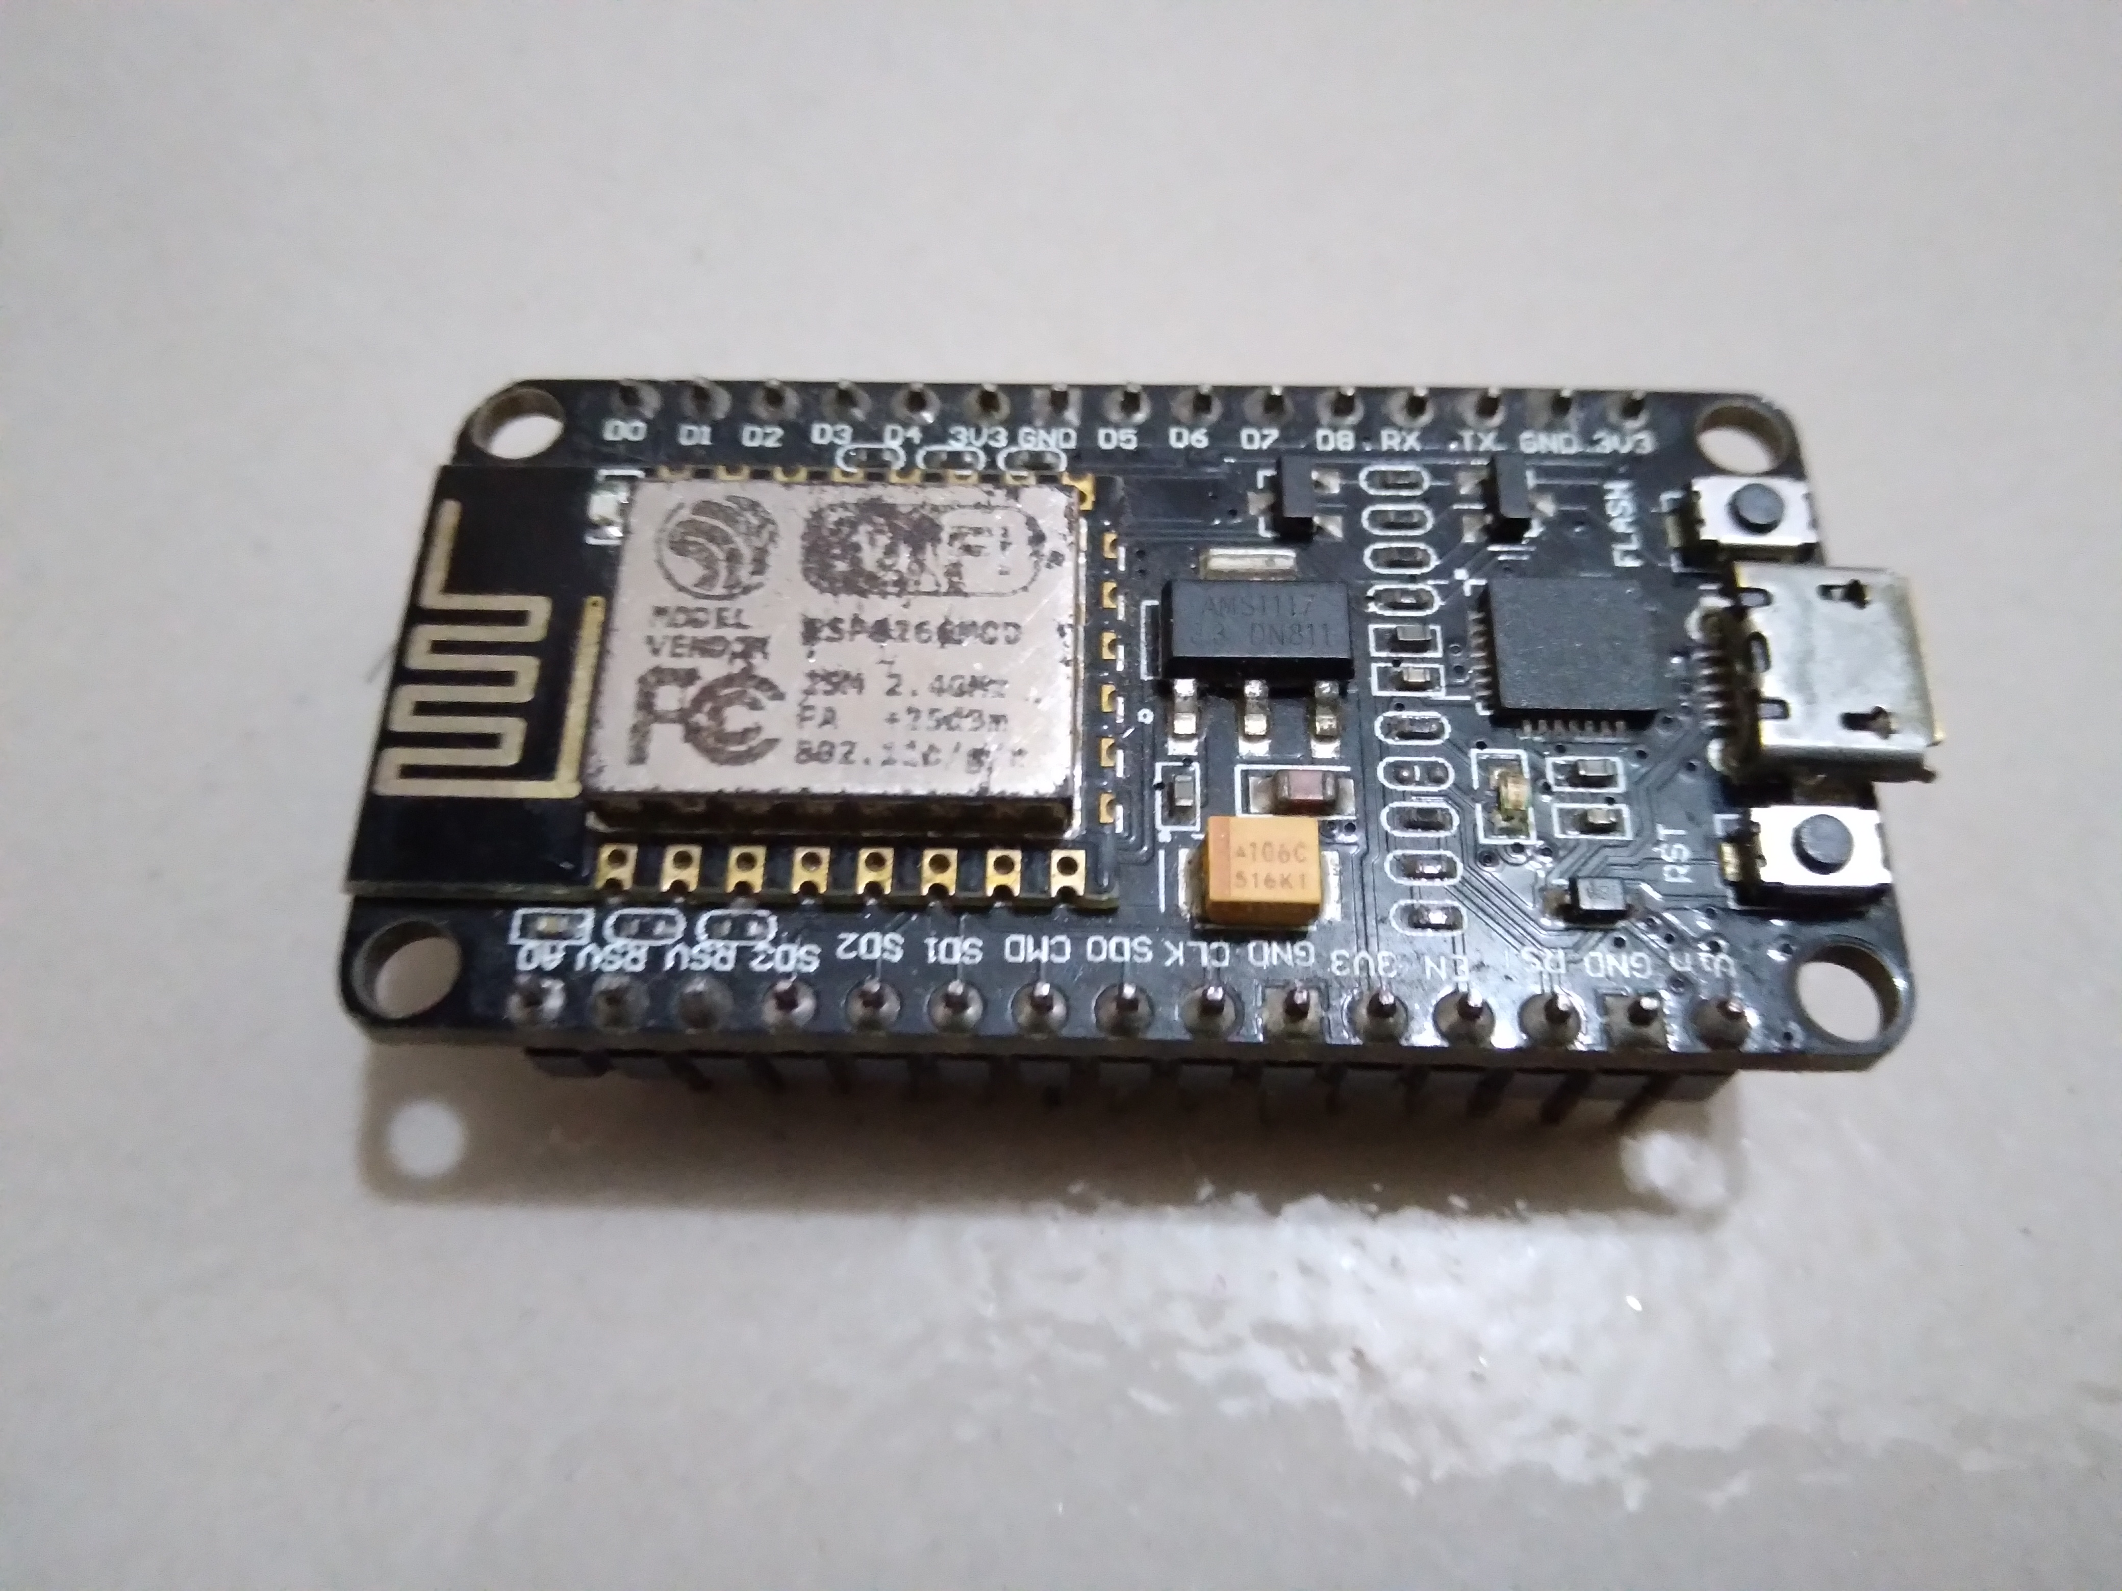
ESP8266
The ESP8266 is a low-cost Wi-Fi microchip, with built-in TCP/IP networking software, and microcontroller capability, produced by Espressif Systems.

Slide 5
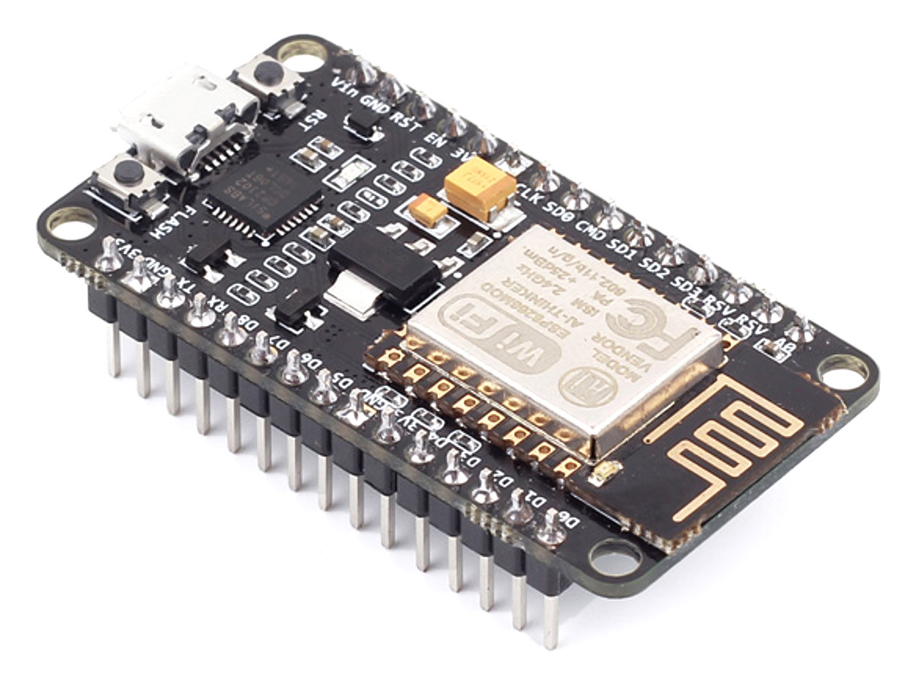
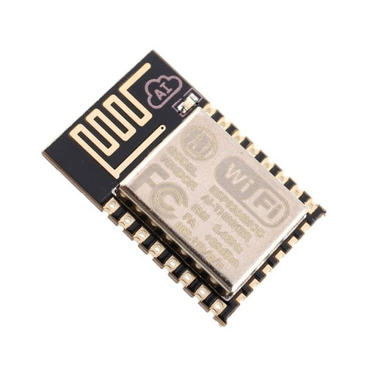
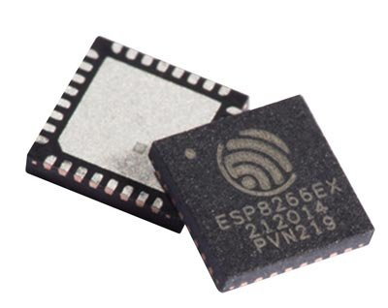
Features of ESP 8266
Processor
Memory
External QSPI Flash
Wifi Connectivity
Software support

Slide 6
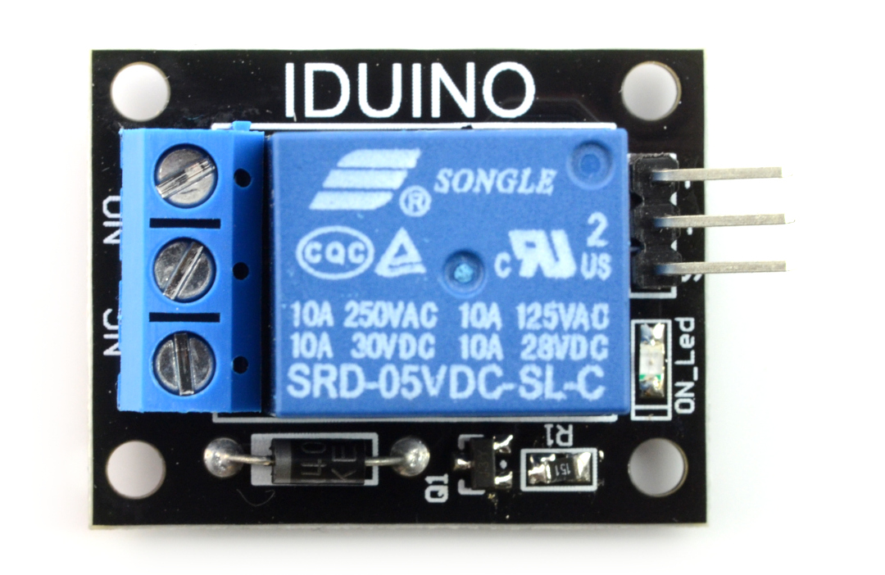
Relay Module
The relay module is an electrically operated switch that can be turned on or off deciding to let current flow through or not.

Slide 7
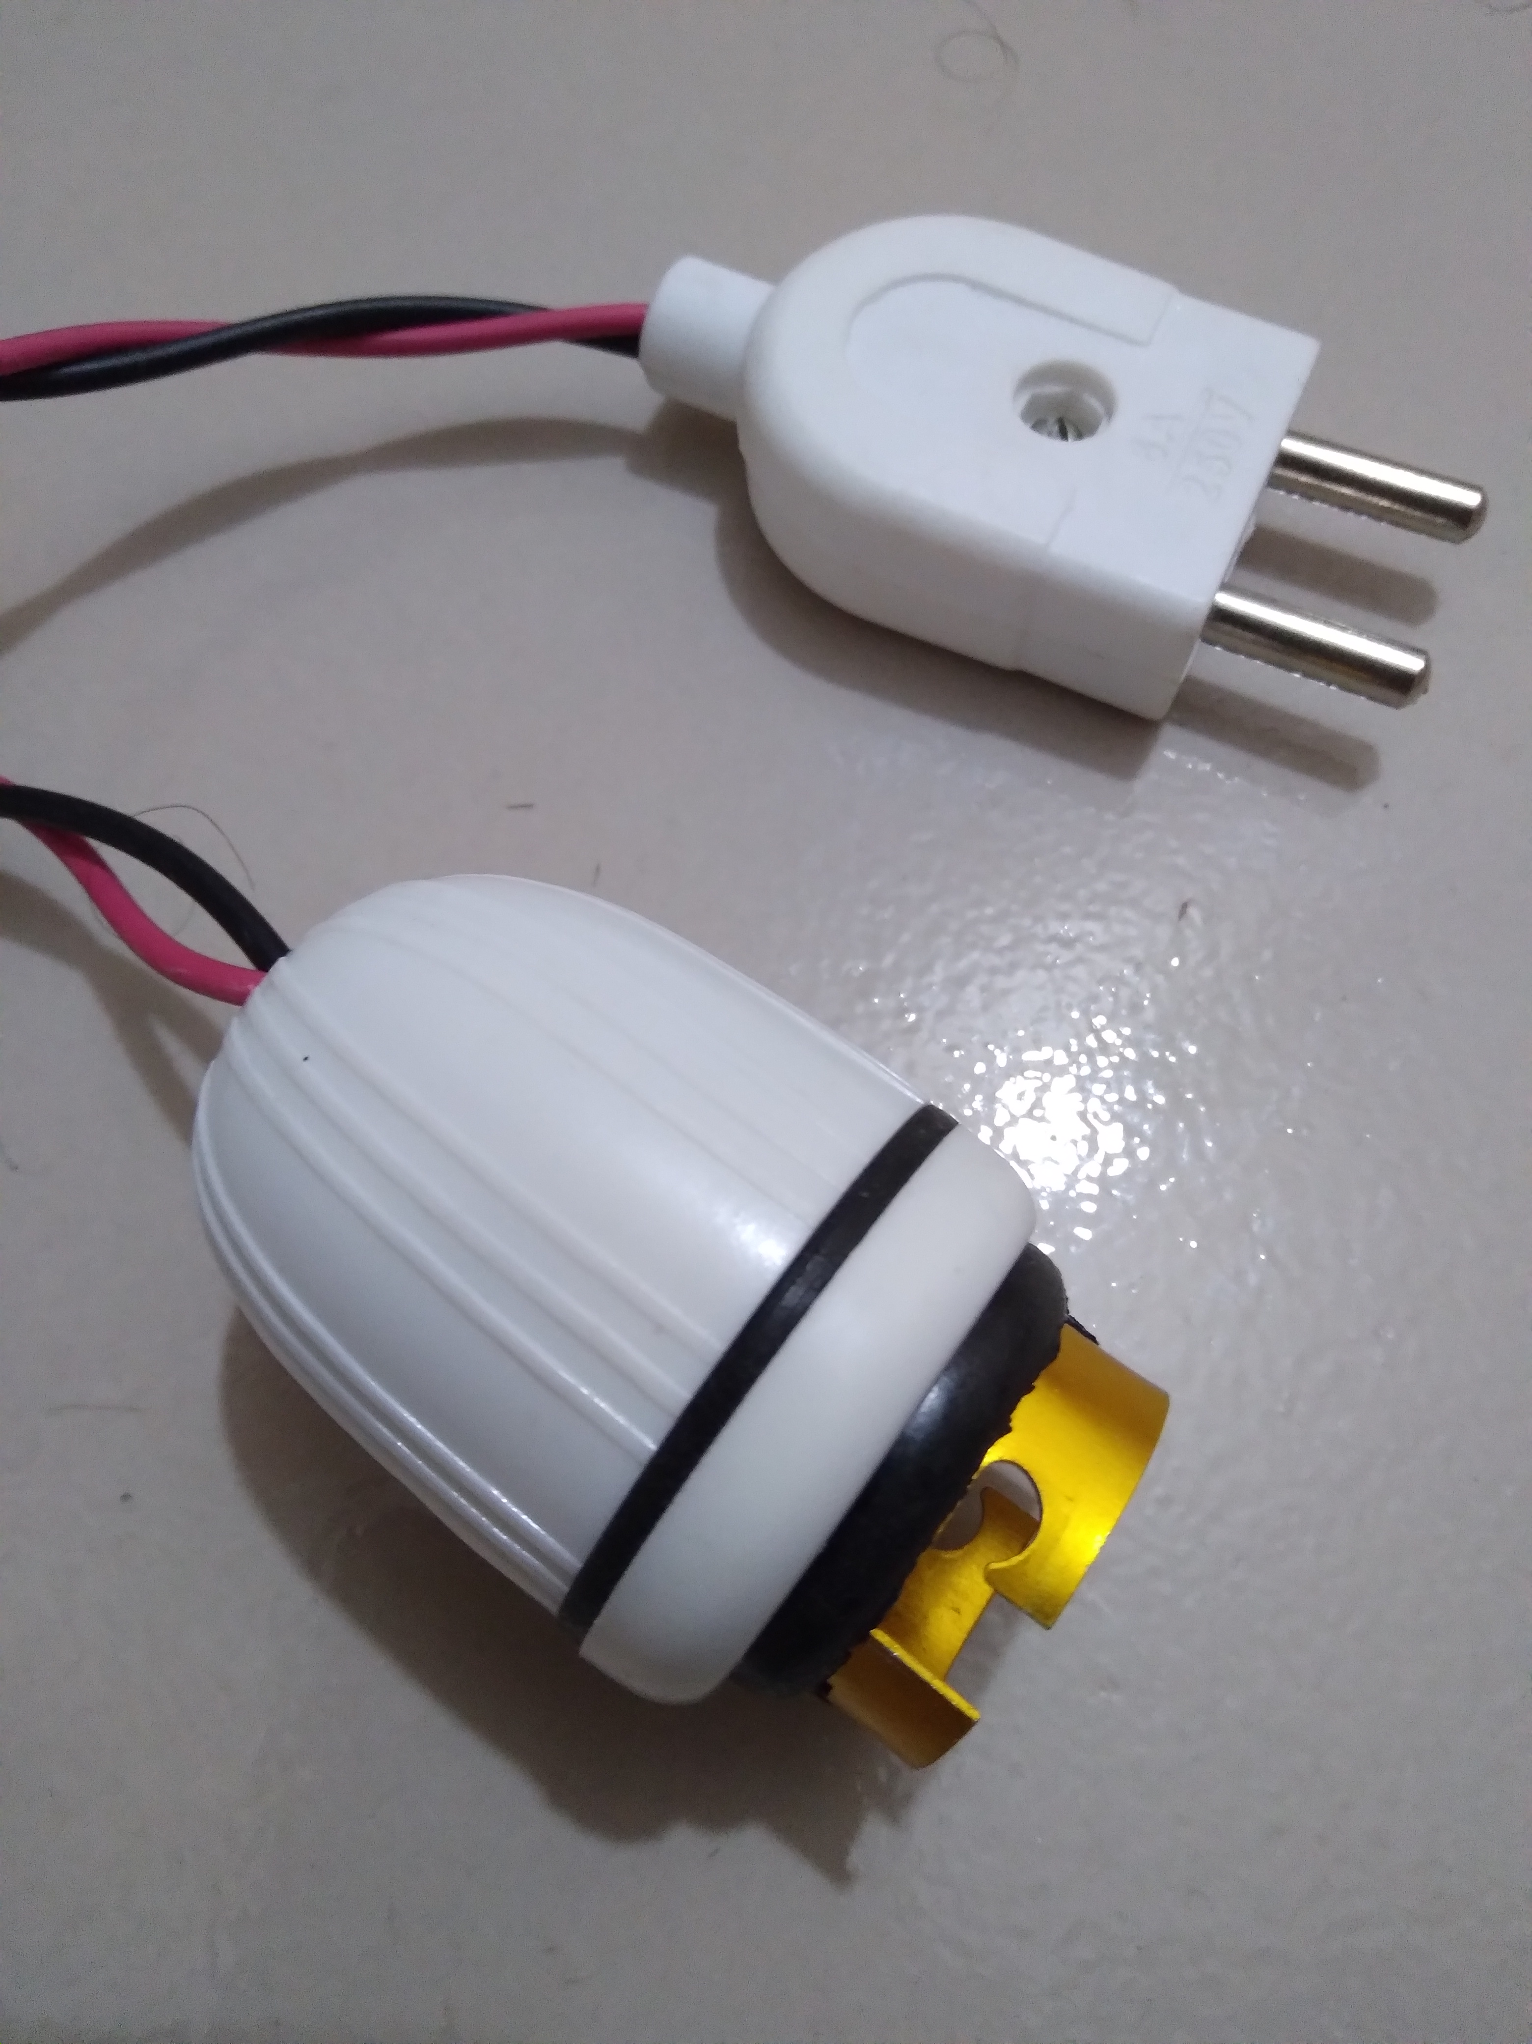
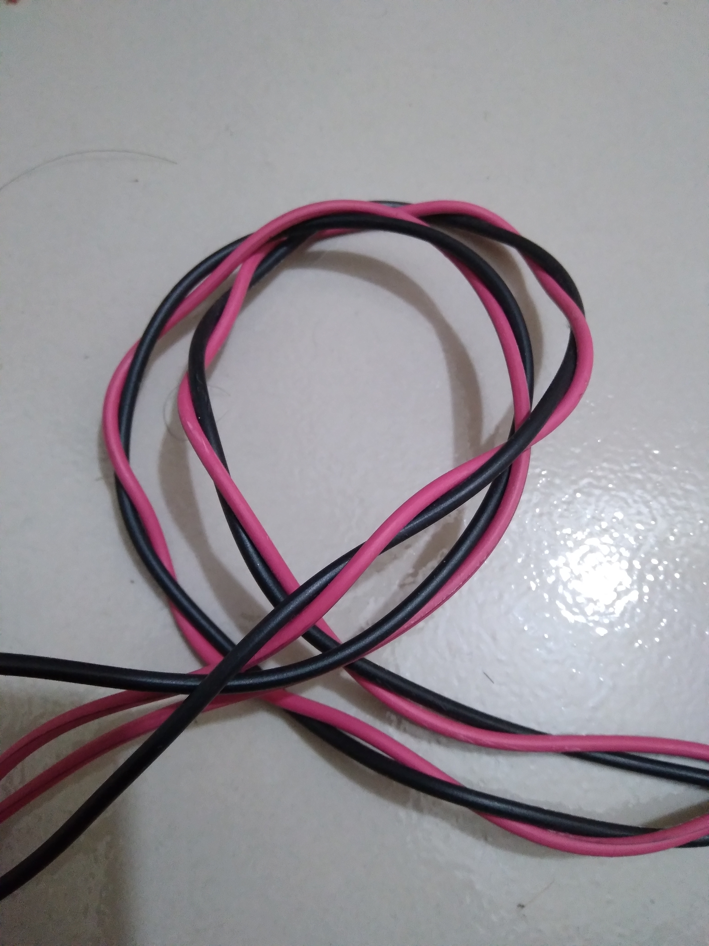
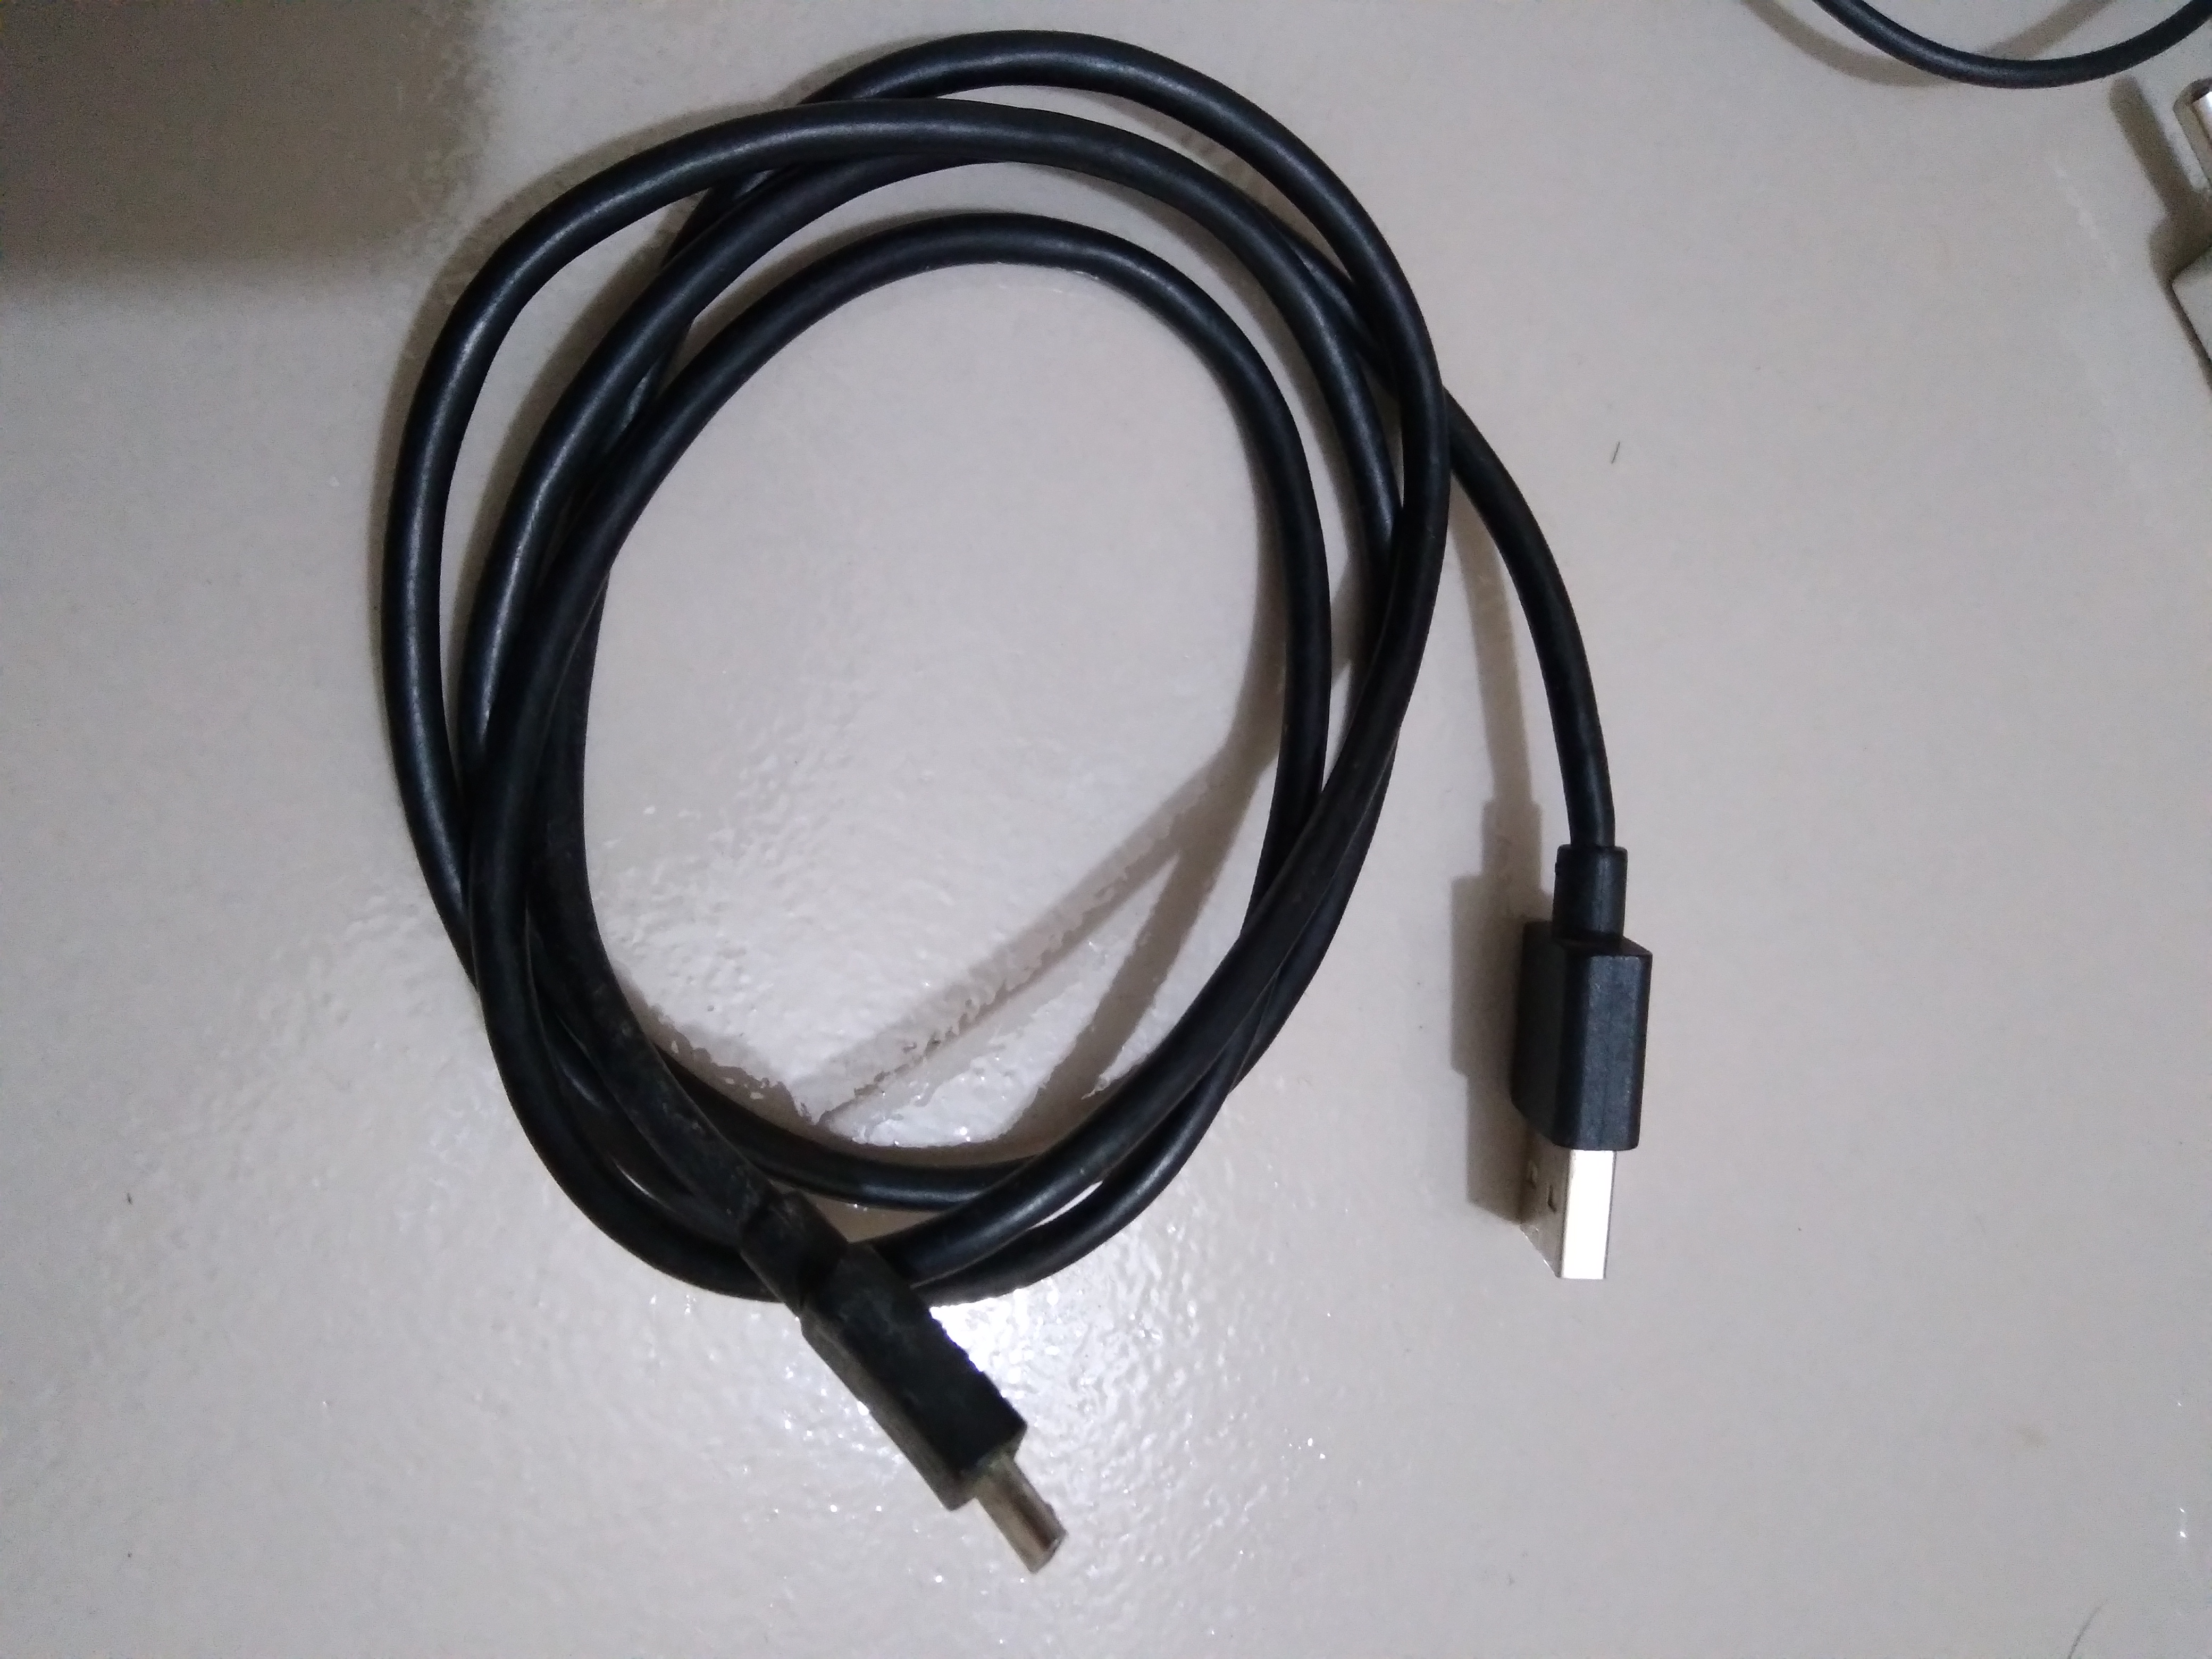
Others Components
Plug & Light Holder
Connecting wire
USB Cable

Slide 8
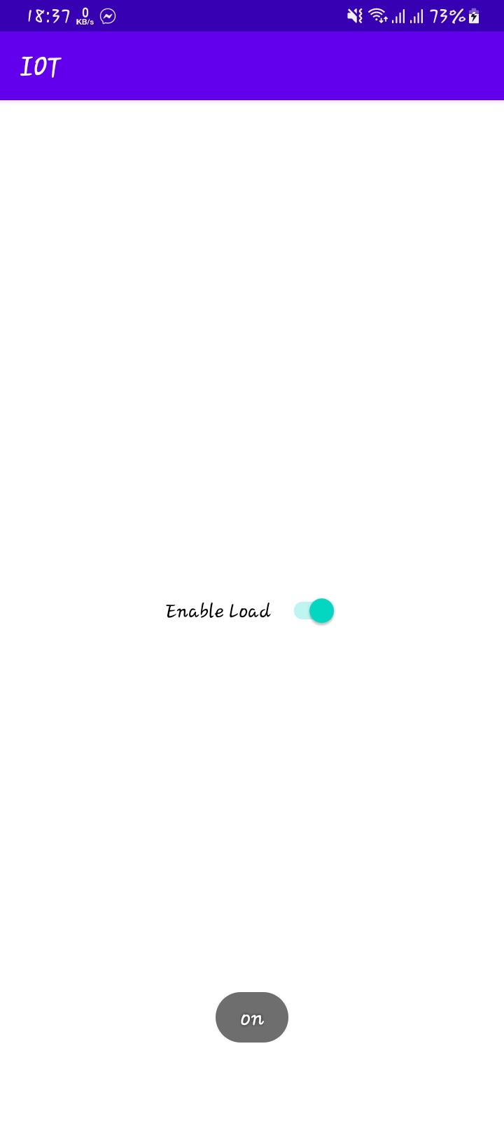
Simple 1 Switch Android App For Controlling Home Automation

Slide 9
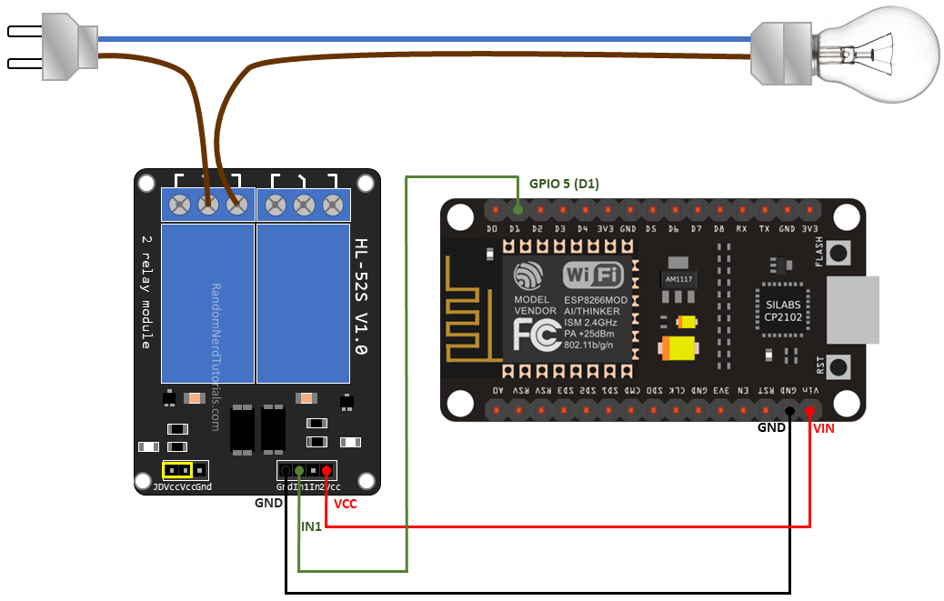
Procedure & Others
Connections
Work flow
discussion

Slide 10


